Slide 1


SAP APM
Maintenance Flows
Version 1.0
April 2025

Slide 2
Equipment Criticality Analysis (ECA)
Process Flow - ECA
Reliability team members
Operation & Maintenance members
ECA cross functional team members (Reliability, Operations & Maintenance)
Operation & Maintenance Manager
Master Data Specialist
1.1 Identify systems for ECA
s
1.2 Identify assets to perform ECA
1.3 Decide ECA cross functional team members
1.4 Collect asset related data such as mining flow diagram, equipment data sheets, SOPs to perform ECA
Environment Impact
1.5 Evaluate equipment failure consequences
Safety Impact
1.6 Determine equipment failure frequency
Financial Impact
1.7 Determine equipment criticality
Target failure Frequency
e
1.8 Approve ECA outcomes
1.9 Populate equipment criticality in ERP

Slide 3
Failure Mode Effect Analysis
Process Flow - FMEA
Reliability team members
Operation & Maintenance members
FMEA cross functional team members (Reliability, Operation & Maintenance)
Operation & Maintenance Manager
s
Perform FMEA for asset class with multiple failure modes
1.4 Decide FMEA cross functional team members
e
1.1 Identify systems to perform FMEA
1.2 Combine assets to identify asset classes
1.3 Identify asset classes with multiple failure modes
1.16 Document FMEA outcomes
For asset classes with single failure mode, initiate maintenance strategy review
1.5 Collect data such as process diagram, equipment installation and operation manual to perform FMEA
Maintenance strategy
1.6 Identify potential failure modes
1.7 Identify all failure effects
1.8 Identify all failure causes
1.9 Assess failure mode severity
1.10 Determine failure mode occurrence
1.11 Assign current detection index on each failure mode
1.12 Determine unmitigated risk priority number (RPN)
1.13 Recommend tasks to mitigate failure causes
1.14 Determine mitigated risk priority number (RPN)
1.15 Approve FMEA recommendations

Slide 4
Maintenance Strategy
Process Flow – Maintenance Strategy
Reliability team members
Operation & Maintenance members
Cross functional team members (Reliability, Operation & Maintenance)
Operation & Maintenance Manager
Master data specialist
s
1.1 Prioritize assets
1.2 Decide team members
1.3 Collect data to prepare maintenance strategy
1.4 Build failure mode library
RCA recommendation
OEM recommendation
1.5 Consolidate and determine maintenance strategies against each failure mode
1.6 Determine frequency of maintenance tasks
1.8 Create operator activity check list
1.9 Create/modify PM tasks lists
1.10 Create/modify PM plans
Failure mode effect analysis library
Equipment history
1.7 Approve maintenance strategy
e
1.11 Implement changes in ERP

Slide 5



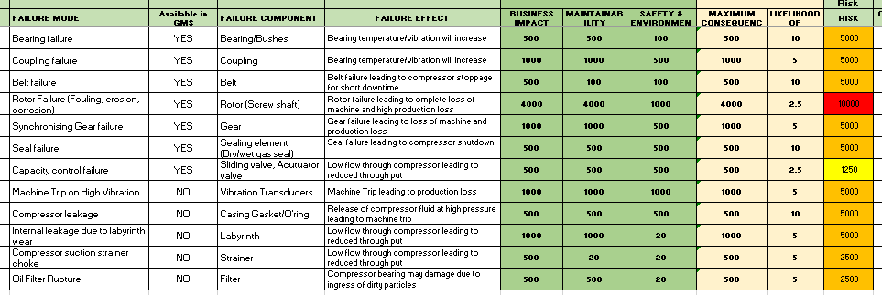
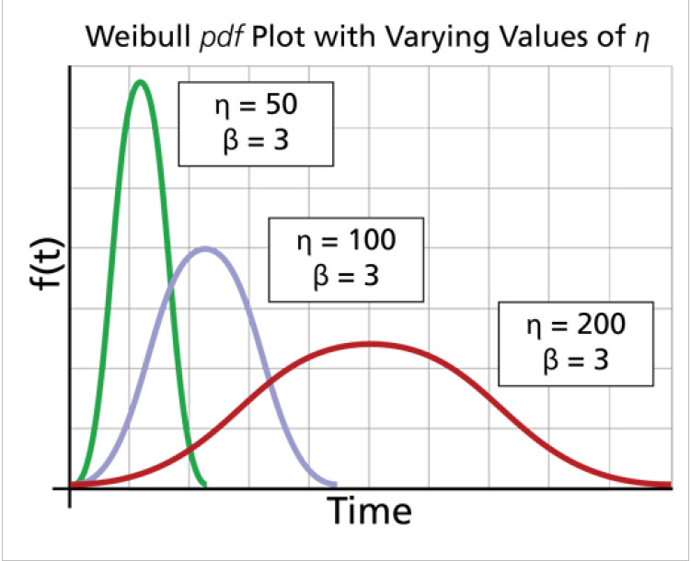
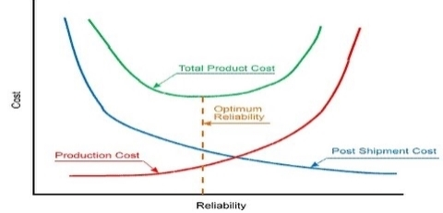
Process Flow – Replacement Strategy
Replacement Strategy Identification Workflow
Data collection & Counter identification
Data collection & Counter identification
Data collection & Counter identification
Data & Documents
1, 4, 13, 16
2, 16
1, 2,4
16
Collect Data
(START)
No. of Asset classes
Identify sub classes & major assemblies
Sub classes & assemblies
Identify As-is Counters
As-Is counter & strategy
Propose suitable Counters
1 | Equipment/ Floc extract with make/model details
2 | Existing Maintenance Plans, Task lists, PRTs for class 4 assets
3 | Notification & Work order history for each class 4 assets
4 | Class/Catalogue profile description details
5 | BOM for all class 4 assets
6 | Asset wise FMEA
7 | Failure codes for each asset class
8 | Asset wise production impact/Bad actor analysis data
9 | Asset wise failure impact on HSE
10 | Failure history with damage, cause & catalogue details
11 | Breakdown & Damage Analysis report
12 | MTTR/MTBF Data for each maintainable items
13 | PFDs/PIDs for assets in scope
14 | Maintenance strategies document
15 | List of different condition monitoring tools/ techniques available
16 | O&M Documents/Equipment drawings (GA/Cross-section)
17 | Risk Assessment Matrix
18 | FMEA template & procedure
Counter for each Asset class/assembly
FMEA & baseline Maintenance strategy
FMEA & baseline Maintenance strategy
FMEA & baseline Maintenance strategy
17,18
5,6,7,8,9,
10,14,15
2,11,14,16
Set up FMEA
Template
Guidelines for failure mode, effect, cause and recommendation
Perform FMEA
Maintenance Task for each failure mode
Establish baseline Maintenance strategy
Identify Function
Identify severity, occurrence & detection
Identify Maintenance task type
Identify Function failure
Identify Function failure
Identify failure effect
Mitigating tasks
Identify Function failure mode
Identify failure cause
Reliability modelling &
Master Data update
1, 4
3,5,10,11,12,15,16
Develop Reliability model
Selected Reliability modelling method
Perform Reliability modelling
Replacement interval
Create/ Update replacement strategy
Maintainable Items
Update Maint. Plans/Items/task lists/PRTs
(STOP)
Gather life Data for equipment
Generate plots estimating reliability or mean life
Cost analysis
Select a lifetime distribution that models life of the item
Estimate the parameters of the distribution
Preventive vs Corrective Maintenance

Slide 6
RCA
Process Flow - RCA
Anyone
Reliability team members
RCA team leader and cross functional team member
Operation & Maintenance Manager
s
1.1 Raise RCA
request
1.2 Approve/Reject RCA request
1.3 Decide RCA team leader & members
1.4 Organize & prioritize evidence collection
e
Maintenance strategy
1.5 Collect data & take interviews
1.6 Develop a timeline
1.7 Perform root cause analysis using a logic tree
1.10 Implement recommendation(s) in ERP
1.8 Determine recommendations
1.9 Review RCA report & recommendation(s)

Slide 7
Reliability Modelling
Process Flow – Reliability Modelling
A
1. Extract relevant data points to calculate MTBF, MTTR and preventive and reactive maintenance cost for failure of component
2. Clean and structure the data to know about material consumption at specific asset location
3. Identify the components chosen for Scheduled Replacement considering time-based failure and risk potential
4. Identify the material that is used for these components
5. Create data templates with all the necessary inputs for Reliability modelling to be fed into any Reliability Modelling tool
9. Update frequency of scheduled replacement for the component in the m-Item
Approved
8. Validate the recommended frequency from relevant stakeholders
7. Obtain the optimum replacement frequency
6. Run the data model on Reliability modelling tool
Yes
Workshops
No
A
To be done by Accenture
To be done by Accenture and client

Slide 8
Maintenance Journey
Process Flow – Maintenance Journey
Build Standards
Strengthen Fundamentals
Move to digital
Asset Data Management
Standards
Predictive Maintenance
Asset Hierarchy Build
Bill of Materials
Critical Assets & Failure Modes
Build Standard & Processes
Asset Data Management
Reliability
Work Management
Maintenance Operating Model
Time series Data
Maintenance Data
Analytics based Predictive Asset Management
Assets
Asset Reliability Management
Asset Integrity
Digital Asset Management
Asset Criticality Assessment
FMEA, Maintenance Strategy
Structural Integrity
Prescriptive Maintenance
Remote Operations
Optimum Maintenance Requirement
Maintenance Optimization & Excellence
Digital Workforce
Maintenance Task list
Maintenance Plan/Item
PRT
Planned work visibility
Planning & Scheduling optimization
Digital work Execution
Location & Materials
Focus on improved master data quality to enable insight generation
Identify all Critical assets & Failure modes to enable predictive maintenance
Update Maintenance Plans/Task list to enable data driven Planning, Scheduling & Execution
Implement predictive maintenance to trigger failure notification
Implement data driven digital use cases to further generate value

Slide 9

THANK YOU

